Slide 1

Serverless
Serverless computing
API Gateway + lambda

Slide 2
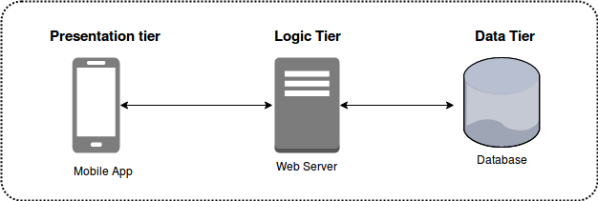
Monolithic multi-tier
Traditional software design for the cloud
Monolithic approach --- one large code base on server
Safe, conservative engineering
No one gets fired for building systems this way :-)

Slide 3
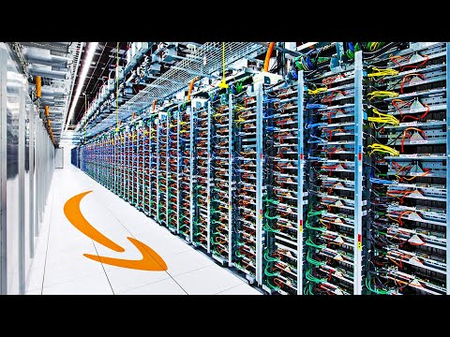
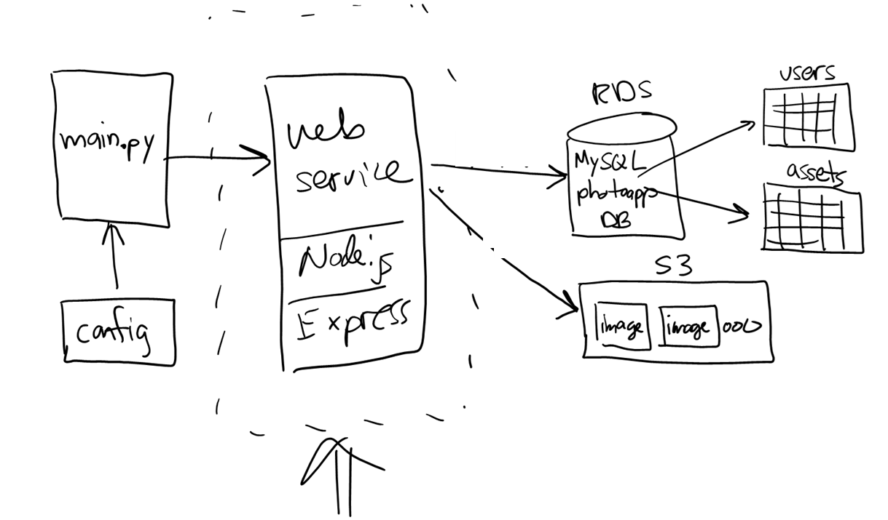

Project 02 --- monolithic web service
//
// PhotoApp web service
//
app.get('/stats', (req, res) => {…});
app.put('/user', (req, res) => {…});
app.get('/users', (req, res) => {…});
app.get('/assets', (req, res) => {…});
app.get('/bucket', (req, res) => {…});
app.get('/image/:assetid', (req, res) => {…});
app.post('/image/:userid', (req, res) => {…});
Notes:
EC2 = Elastic Compute

Slide 4
Alternative designs?
Microservices
Break monolithic system apart --- easier to develop, update, release, but more moving parts to manage
Example: Netflix was one of the first to do this
Event-driven
Design based on events that occur / application states
Example: food delivery => menu, order, purchase, prepare, deliver
Serverless computing…

Slide 5
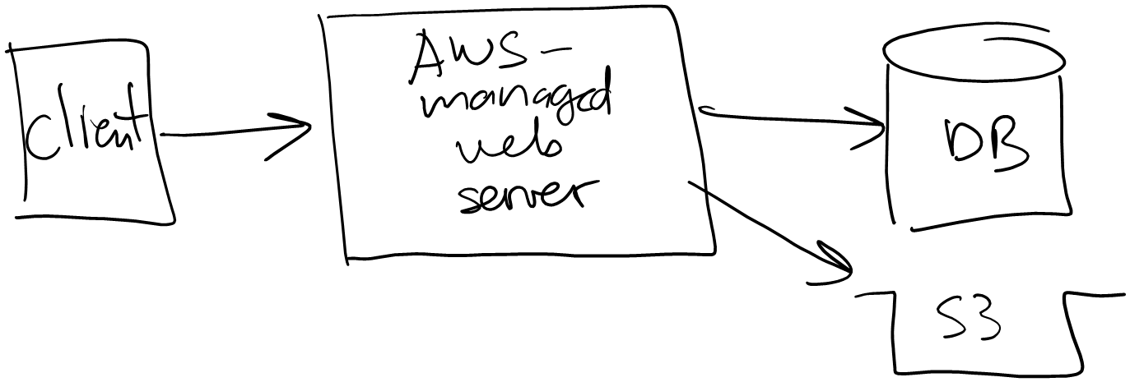
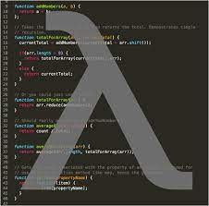
Serverless doesn't mean no server
We still have a web server…
We just don't manage it

Slide 6
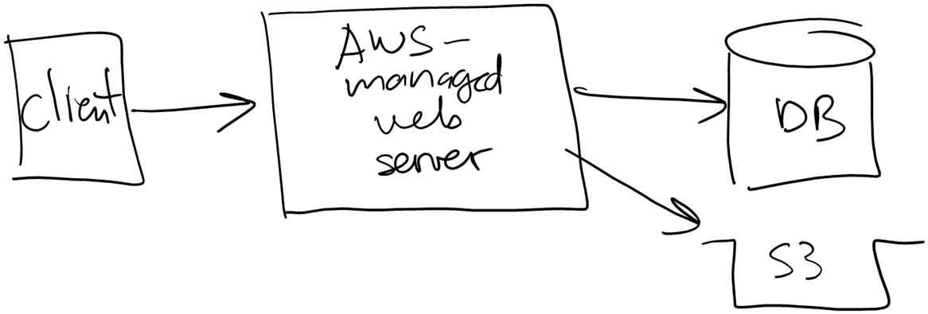
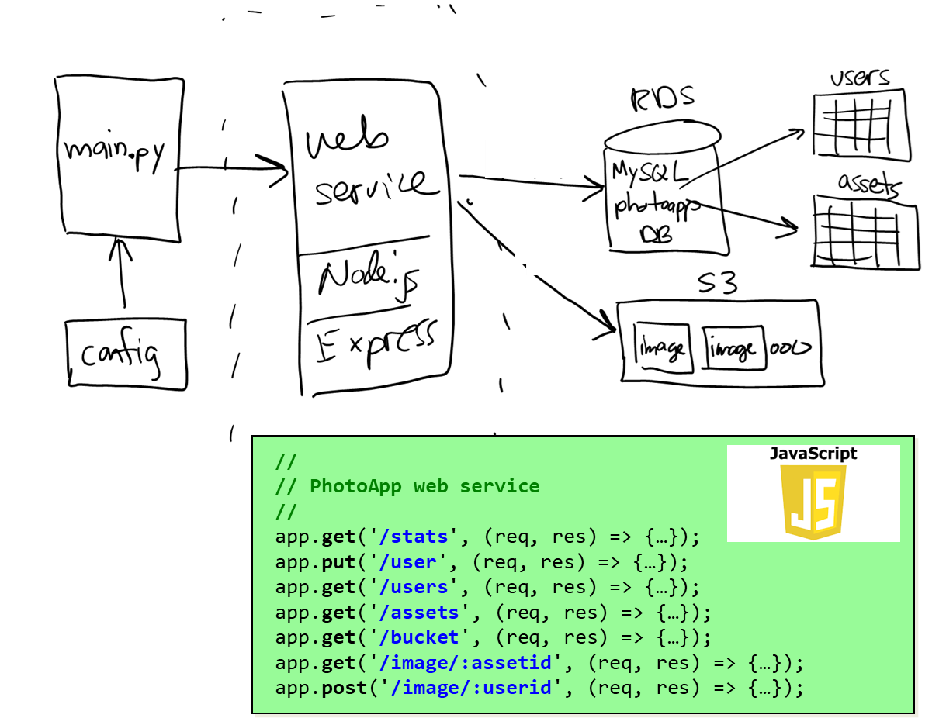
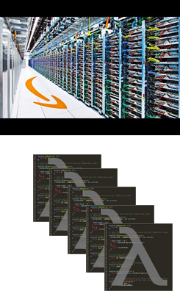
Why serverless?
Advantages:
Break monolithic code base into microservices / functions
Enabling development in whatever language / platform makes the most sense --- JavaScript, Python, Java, …
Quicker to update and release functions / add new functionality
Retain advantages of web server tier but let AWS manage
Scalability of server & functions w/o idle capacity (saving $)
longer latency ☹
Notes:
Don't like the longer latency? => micro-services…

Slide 7
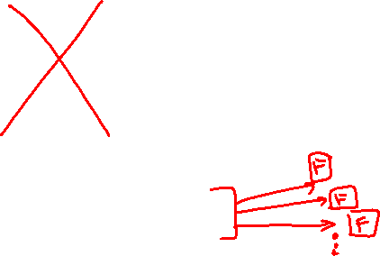
Why serverless?
Advantages:
Break monolithic code base into microservices / functions
Enabling development in whatever language / platform makes the most sense --- JavaScript, Python, Java, …
Quicker to update and release functions / add new functionality
Let AWS manage the web server
Scalability of server & functions w/o idle capacity (saving $)
longer latency ☹
Notes:
Don't like the longer latency? => micro-services…

Slide 8
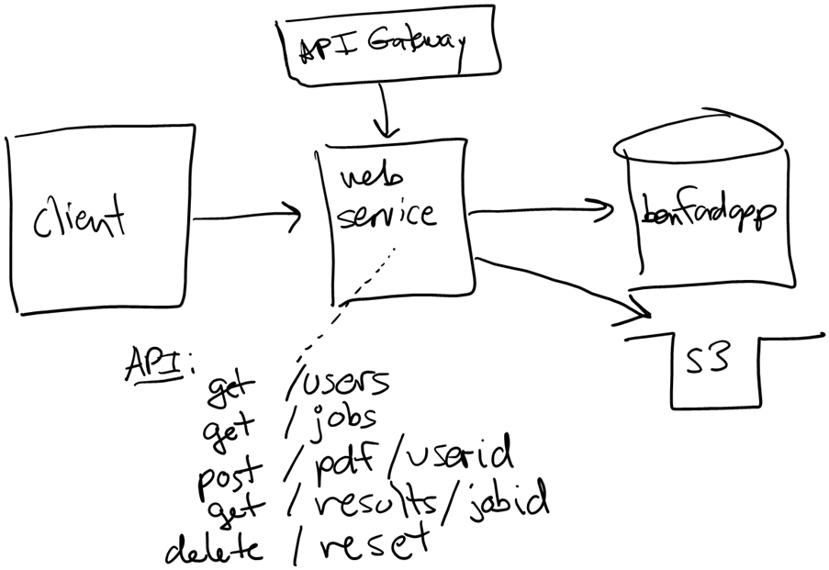
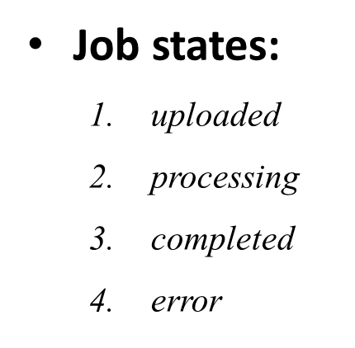
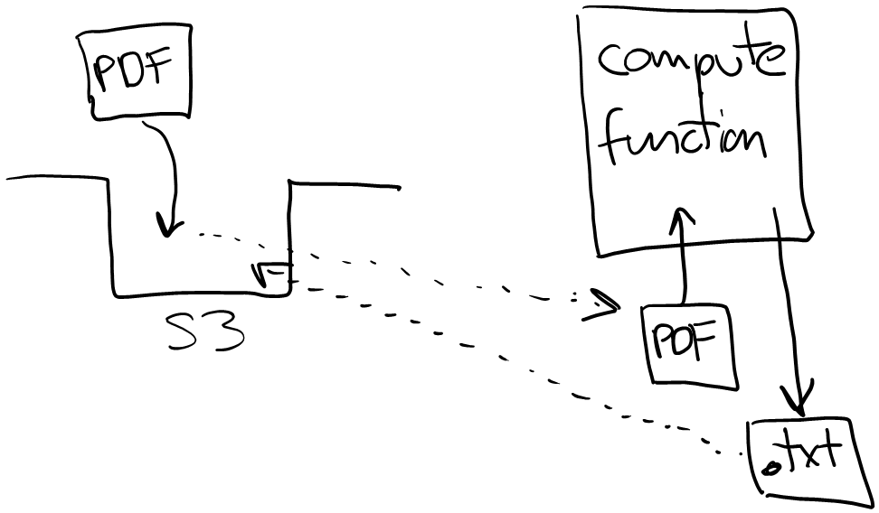
Example: Project 03
Serverless and event-driven…

Slide 9
AWS lambda
By far the simplest, least expensive way to compute
EC2, EKS, ECS, Fargate
Elastic Beanstalk
API Gateway + Lambda
Lambda
function
Notes:
Azure functions (Microsoft), Cloud functions (Google)

Slide 10
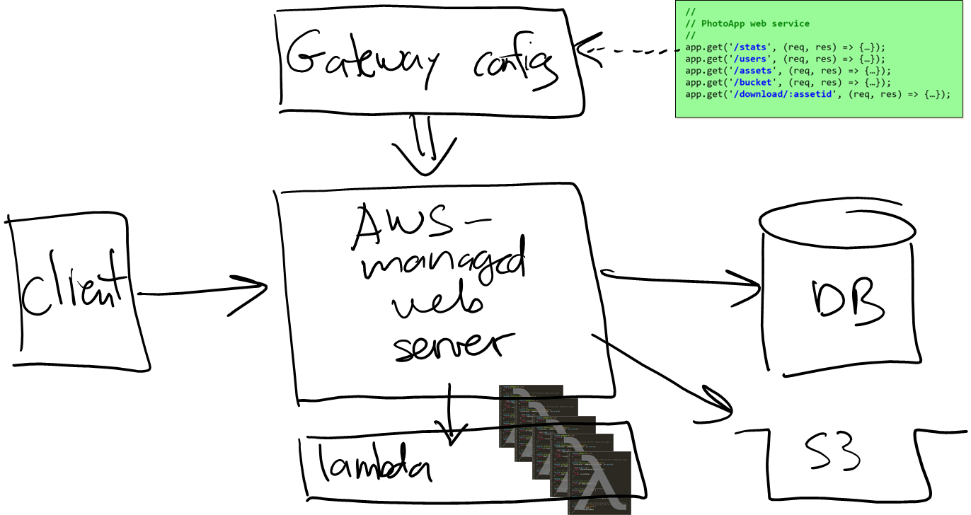
Serverless computing with API Gateway
Just another step in the evolution of making AWS easier:
EC2, EKS, ECS, Fargate
Elastic Beanstalk
API Gateway + Lambda

Slide 11
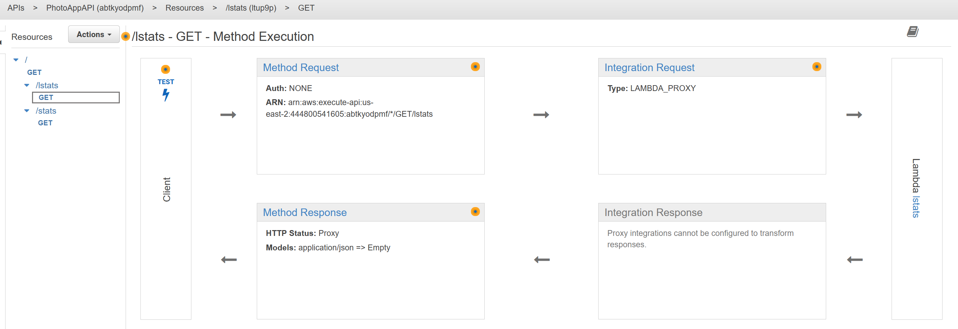





API Gateway
API Gateway allows you to define a RESTful API that forwards to other services / lambdas
Define HTTP verb and URL path (e.g. GET /movies)
Specify target…

Slide 12
Need faster response (lower latency)?
Replace lambda with faster technology (more $)…
EC2, EKS, ECS, Fargate
Elastic Beanstalk
…
Lambda
Notes:
On the path to microservices…

Slide 13
That's it, thank you!

